Slide 1

Green Pace
Security Policy Presentation
Developer: Astrid French

Slide 2

OVERVIEW: DEFENSE IN DEPTH
What is DiD?
It includes security principles, AAA (Authentication, Authorization, and Accounting), coding standards, and data encryption.
Layers of protection help detect coding vulnerabilities.

Slide 3
THREATS MATRIX
Likely High probability of happening | Priority Requires immediate actions
Low priority A task that can be addressed later | Unlikely Low probability of happening

Slide 4
10 PRINCIPLES
Validate Input Data
Heed Compiler Warnings
Architect and Design for Security Policies
Keep It Simple
Default Deny
Adhere to the Principles of Least Privilege
Sanitize Data Sent to Other Systems
Practice Defense in Depth
Use Effective Quality Assurance Techniques
Adopt a Secure Coding Standard

Slide 5
CODING STANDARDS
SQL Injection – Protects against unauthorized database access by ensuring that SQL queries are utilized safely.
Data Type – Ensures data is used correctly to prevent errors and overflow.
Data Value – Ensures that input data meets expected formats to prevent processing harmful data.
Preprocessor – Organizes the code and reduces dependencies and compilation issues.
Integers – Ensures that improper arithmetic operations are avoided to prevent overflow and underflow.
String Correctness – Ensures that strings are validated to prevent overflows.
Expressions – Ensures the use of correct formulas and expressions to prevent bugs.
Assertions – Detects logical errors to prevent unexpected issues during runtime.
Memory Protection – Restricts access to specific memory locations to enhance security.
Exceptions – Provides a controlled way to handle errors, preventing application crashes and maintaining stability in case of unexpected conditions.

Slide 6
ENCRYPTION POLICIES
Encryption in Rest:
Protects data stored in the system.
Prevents data values from being stolen.
Encryption in Flight:
Protects data during transfer.
Prevents data from being stolen during transmission.
Encryption in Use:
Protects data while being used; for example, when entering a password.
Reduces the risk of data breaches during data input.

Slide 7
TRIPLE-A POLICIES
Authentication:
Ensures that only the right users can access the system.
Achieved by verifying users' identities.
Authorization:
Different users have different permissions within the system.
Controlled by limiting user access rights.
Accounting:
Records user interactions.
Helps detect unauthorized access early.

Slide 8
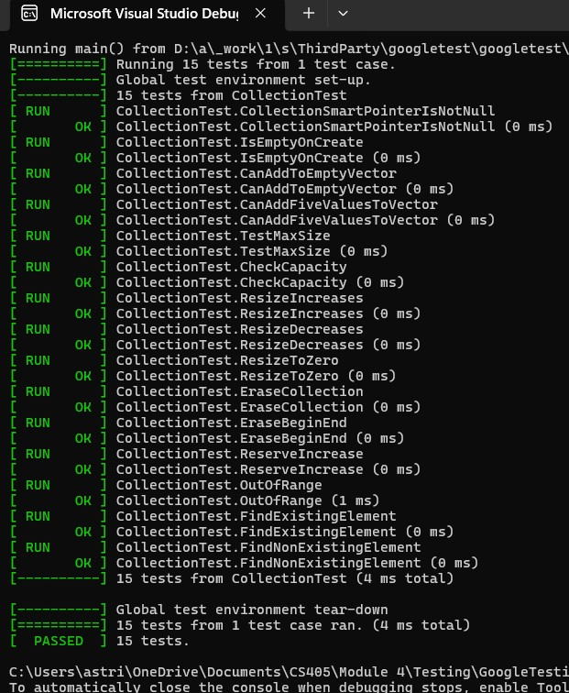
Unit Testing
A testing technique used during development to verify that functions work as intended, catch bugs early, ensure functionality, and maintain code quality by following ten coding principles.

Slide 9

AUTOMATION SUMMARY

Slide 10
TOOLS
The DevSecOps is the transition from DevOps, the pipeline integrates security and secure coding practices within the software development life cycle.
Example Tools: SAST (Static Application Security Testing), Parasoft C/C++testing, Git

Slide 11
RISKS AND BENEFITS
Don’t Leave Security Until the End! Prevent issues early to catch errors before they become significant problems.
Use tools to help! These tools can help minimize flaws in the program.

Slide 12
RECOMMENDATIONS
Maintain Documentation
Follow Coding Standards
Foster Transparency in SDLC
Provide Continuous Updates
Act Quickly
Conduct Regular Code Reviews
Conduct Security Testing

Slide 13
CONCLUSIONS
.
.
Documentations
Keep monitoring any change of the process
Validate the works intendedly work by the guide
Testing often
Start testing early to prevent any error from the beginning
Save time and money
Applies Defense in Dept policy
Layered the security
Reducing risks

Slide 14
REFERENCES
Beschokov, M. (2024, June 7). What is defense in depth? Strategy for cybersecurity. Wallarm. https://www.wallarm.com/what/defense-in-depth-concept
Gillis, A. S. (n.d.). Authentication, authorization and accounting (AAA). TechTarget. https://www.techtarget.com/searchsecurity/definition/authentication-authorization-and-accounting
Lupșan, S. (2022, August 9). Types of encryption for in motion, in use, at rest data. Cyscale. https://cyscale.com/blog/types-of-encryption/
IT Security. (2021, September 1). Defense-in-depth cybersecurity guide. US Signal. https://ussignal.com/blog/moving-beyond-blinky-box-security-to-defense-in-depth-security
Ryther, J. (2022, February 6). Don’t leave security to the end. Medium. https://medium.com/@jryther91/dont-leave-security-to-the-end-ca13b107d4

